Slide 1
The Society of the Patricians
Frank Duff’s answer to Catholic “Mutism”
Legion of Mary Handbook, Chapter 38

Slide 2
What is “Mutism?”
Cardinal Suenens sums up the position thus:
“It is said that those outside the Church will not listen. But the real truth is that the Catholics will not speak.”

Slide 3
Where does the word Patricians come from?
The term Patricians, like most of the other Legion names, is derived from the terminology of ancient Rome. The Patricians were the upper of the three grades of society, that is, the Patricians, the Plebs, the Slaves. But our Patricians aspire to bind all social grades into one spiritual nobility. Moreover the Patricians were supposed to be full of love of their country and of responsibility for its welfare. So our Patricians must be supporters of their spiritual fatherland, the Church.

Slide 4
Attributes of the Society
Oriented towards the building up of the religious knowledge of the people
Open to all Catholics
  (they do not need to be practicing Catholics, only that their allegiance be broadly Catholic)
Should have a “family spirit”
Not a debate; all should make some input
Meetings are held monthly
Size should be less than 50 (typical number is 10-20)

Slide 5
Organization of the Society
Each group is affiliated to a praesidium
The chairperson must be an active legionary
There must be a spiritual director

Slide 6
Layout of the Meeting Room
Legion Altar
Sign-in Table
Food Table
Information Table

Slide 7
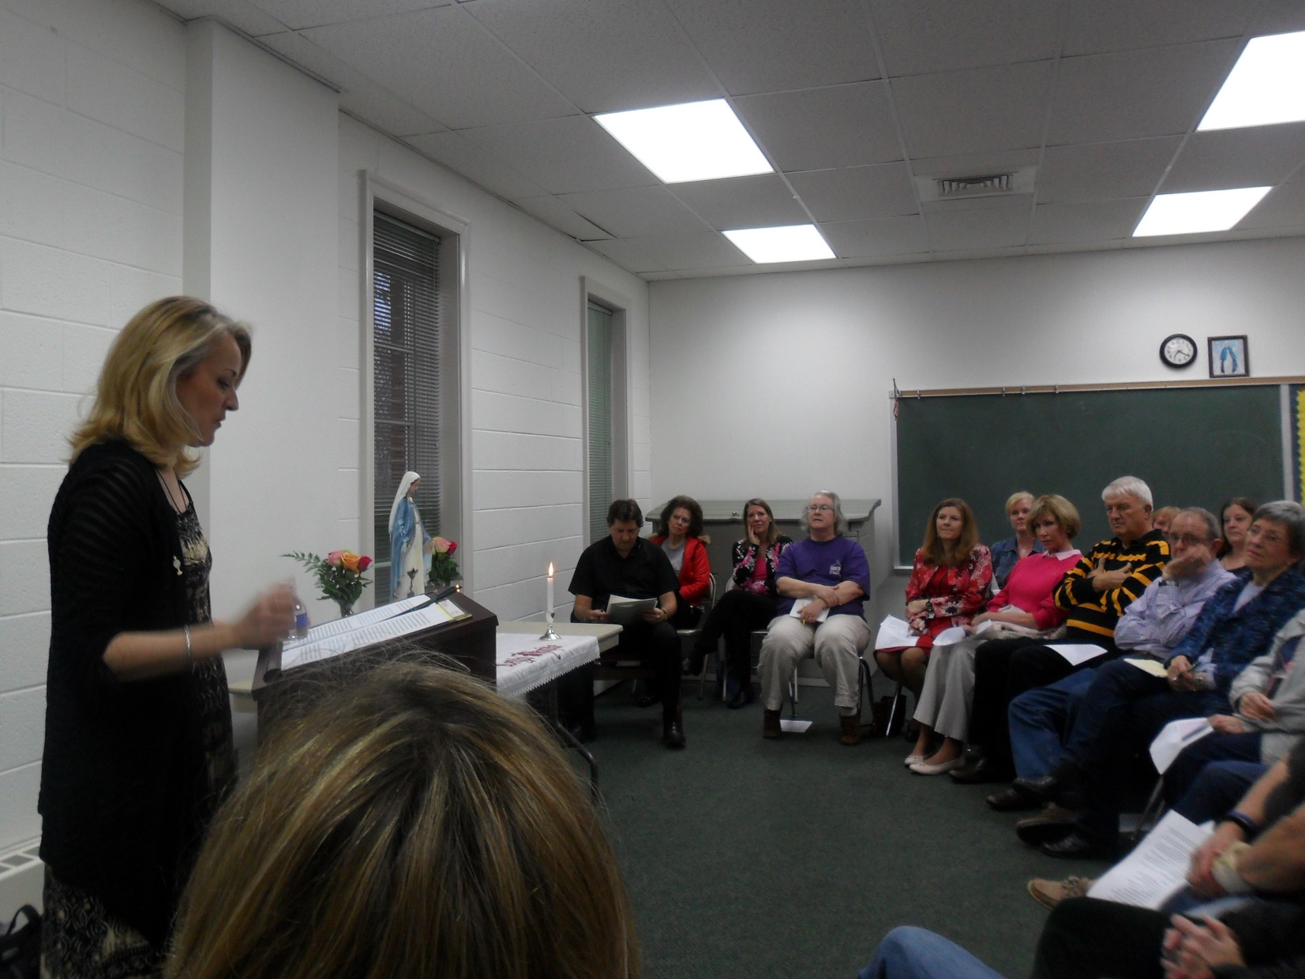
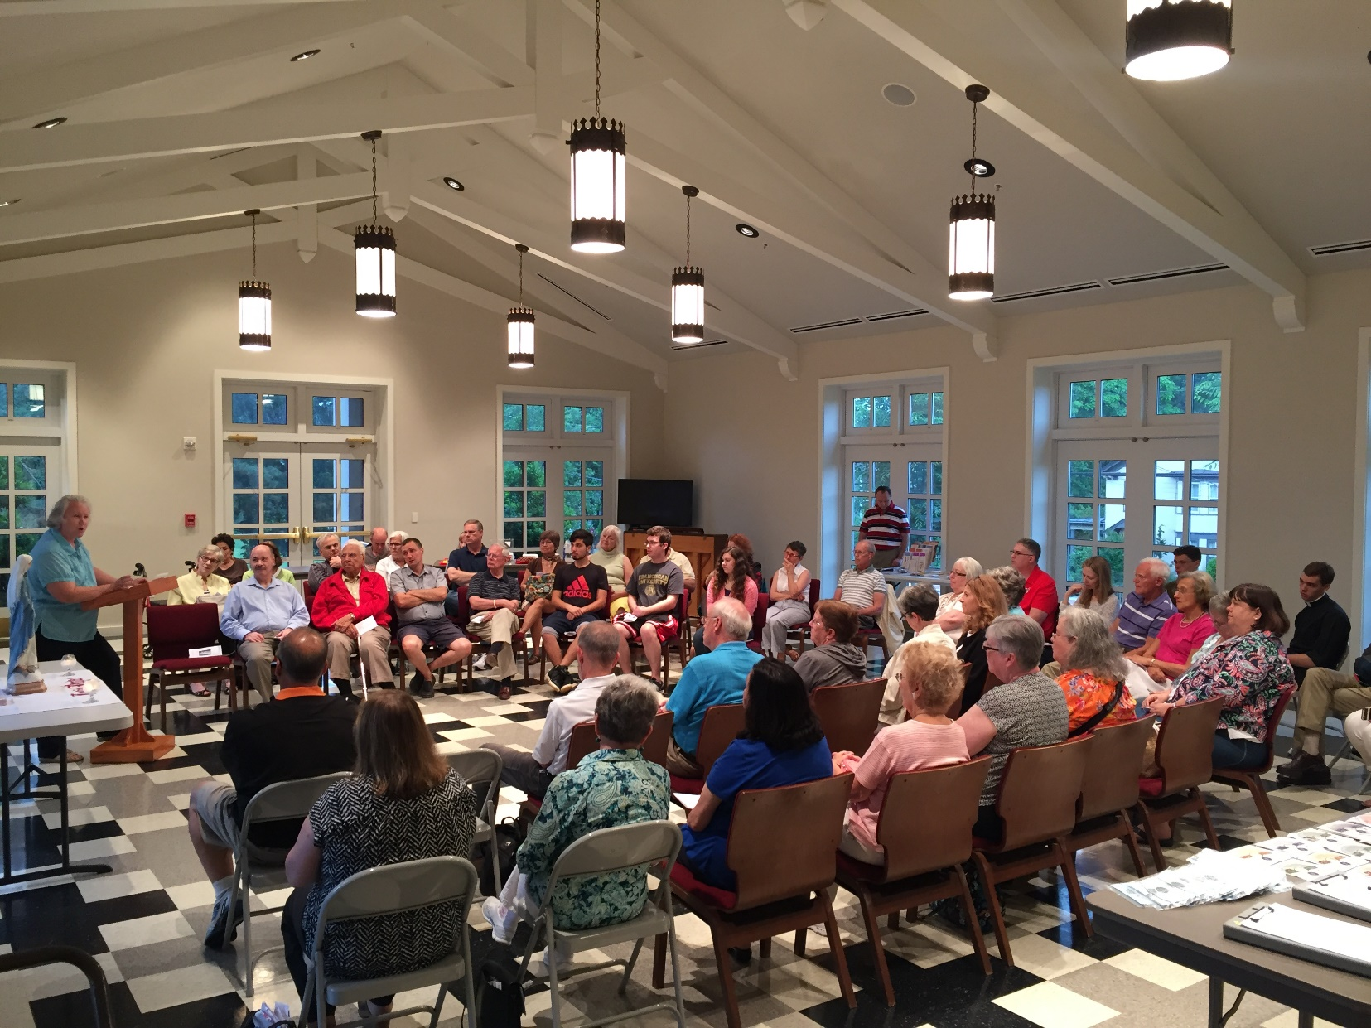
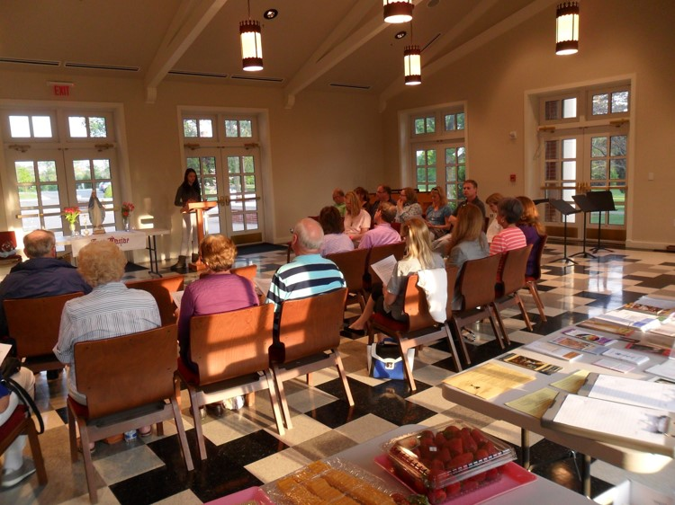
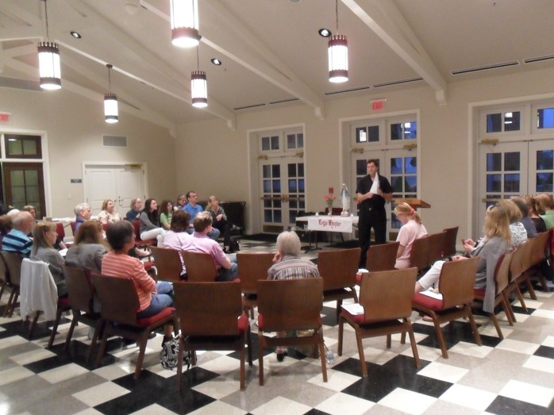

Slide 8
Order of the meeting
The Patrician prayer
15 min talk by layperson
General Discussion (ends 1 hr after beginning of meeting)
Financial Statement
Light Refreshments (15 minute break)
15 min talk by Spiritual Director
General Discussion (ends 5 min from end of meeting)
Selection of next month’s topic and speaker

Slide 9
Patrician Principles (Handbook, Chap 38, pages 266-270)
Group Psychology
Painful Pauses
Postponement of Solution
The Asking of Questions
  The principle members don’t answer them
Building Up
The Key Roles
The Interpreting Principle
Giving God Something to Work On

Slide 10
Useful Aids for Groups
Sample Chairperson’s Script
Sample Financial Statement
Sample Tri-Fold
Examples of Topics for Patricians Meetings
Sign-in Sheet
E-mail List

Slide 11
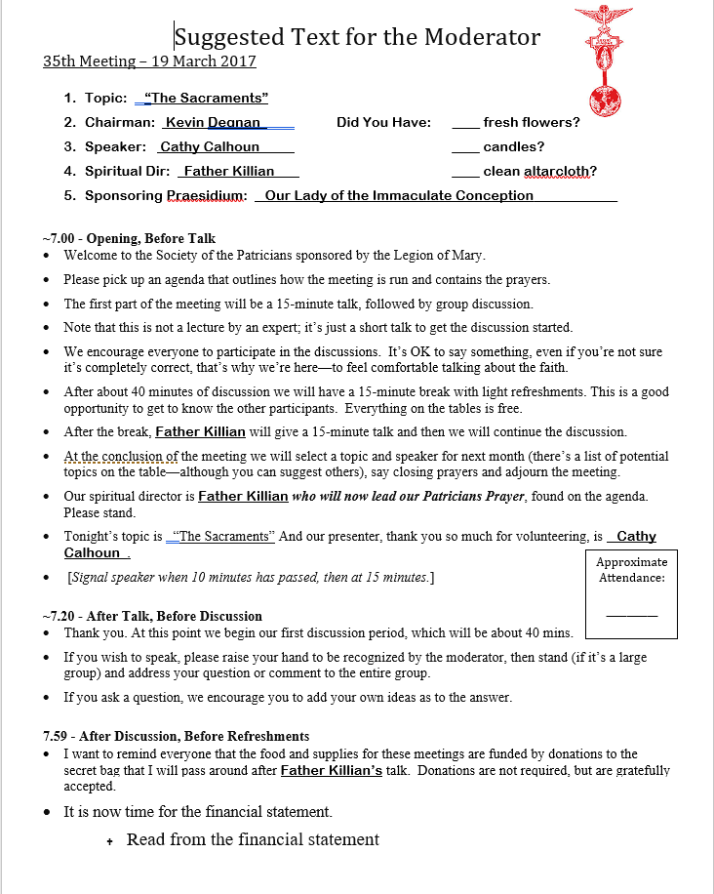
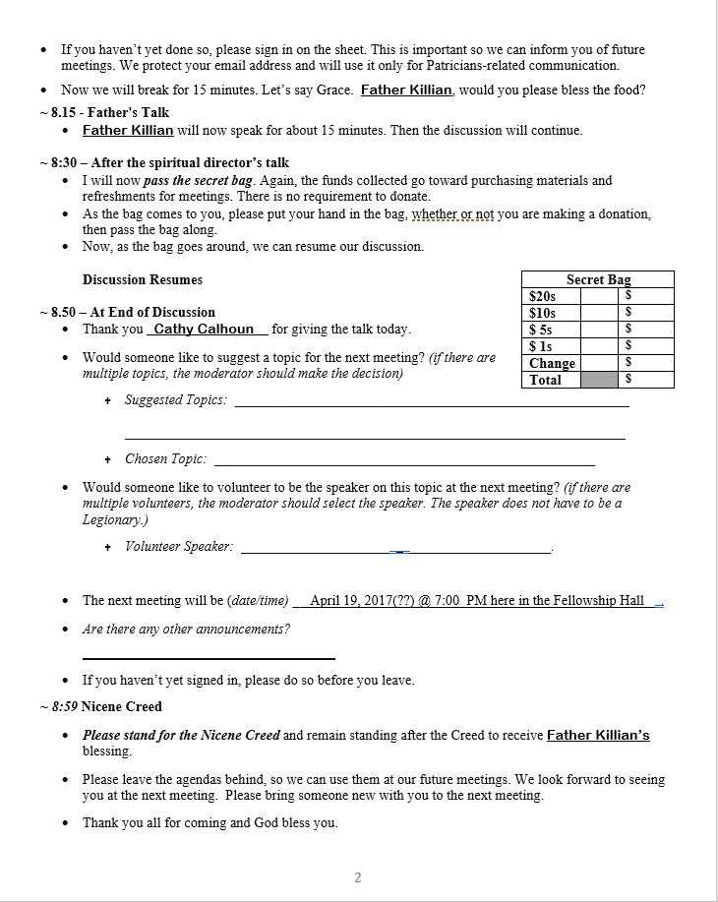
Sample Moderator’s Script

Slide 12
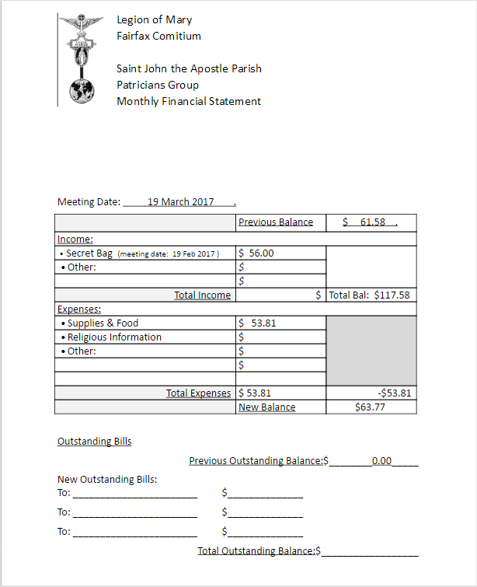
Sample Financial Statement

Slide 13
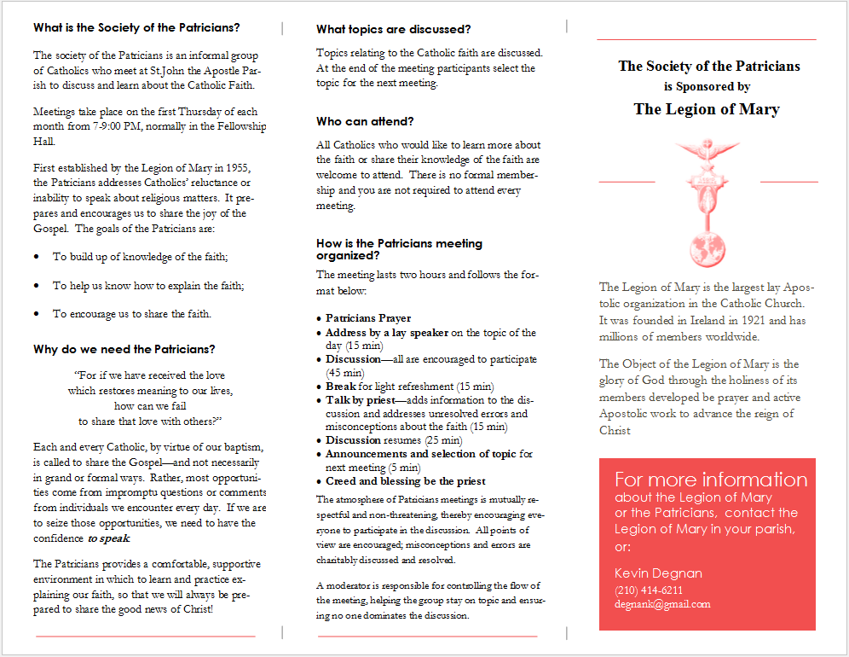
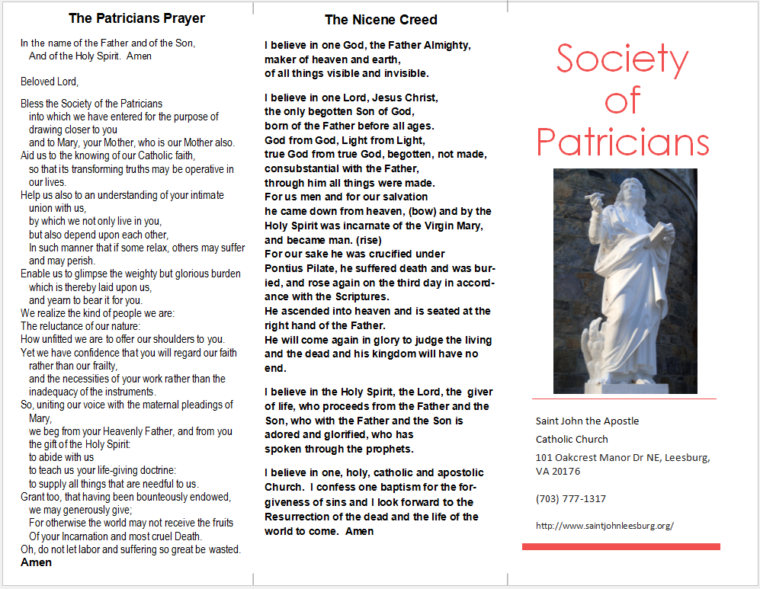
Sample Tri-fold for Attendees

Slide 14
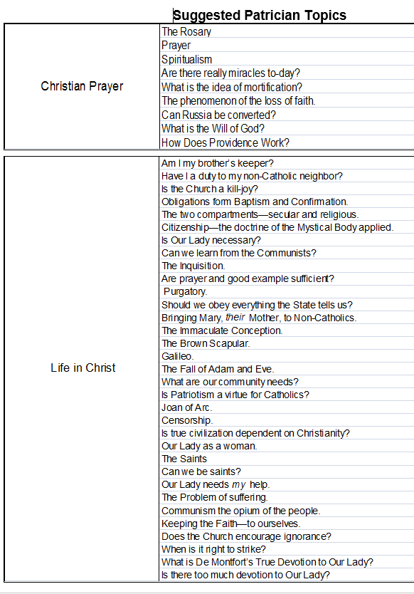
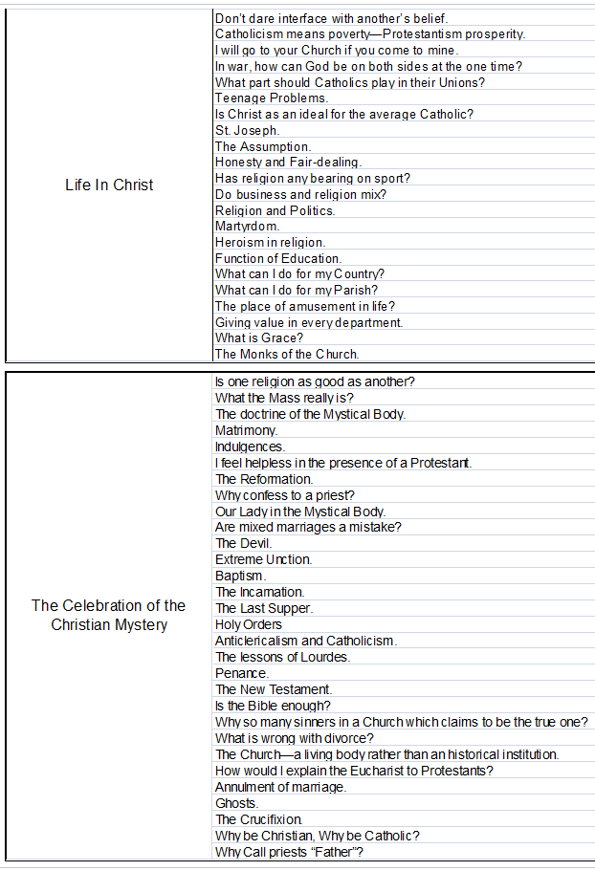
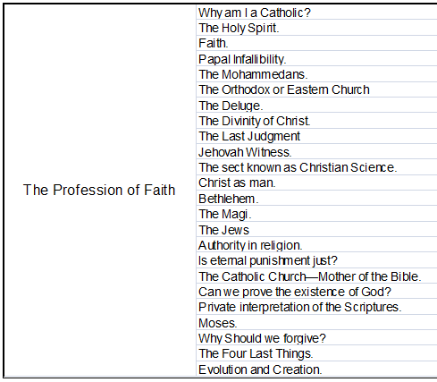
Examples of Topics for Patricians Meetings

