Slide 1
SUBSTANTIAL HEROIC LEGION WORK
SR. SEGGY ACOSTA

Slide 2
ACCEPTABLE WORKS MUST:
“The performance of a substantial active legionary work, in the spirit of faith, and in union with Mary, in such fashion that in those worked for and in one’s fellow members the Person of Our Lord is once again seen and served by Mary His mother.” Standing Instructions
Be controlled by the Legion of Mary
Be assigned by the President, not decided by oneself
Be direct personal contact
Be uplifting to another soul
Be done with a partner (pairs)
Be approved by the Pastor

Slide 3
WORKS CLASSIFICATION
CONSOLATION
CONSERVATION
CONVERSION

Slide 4
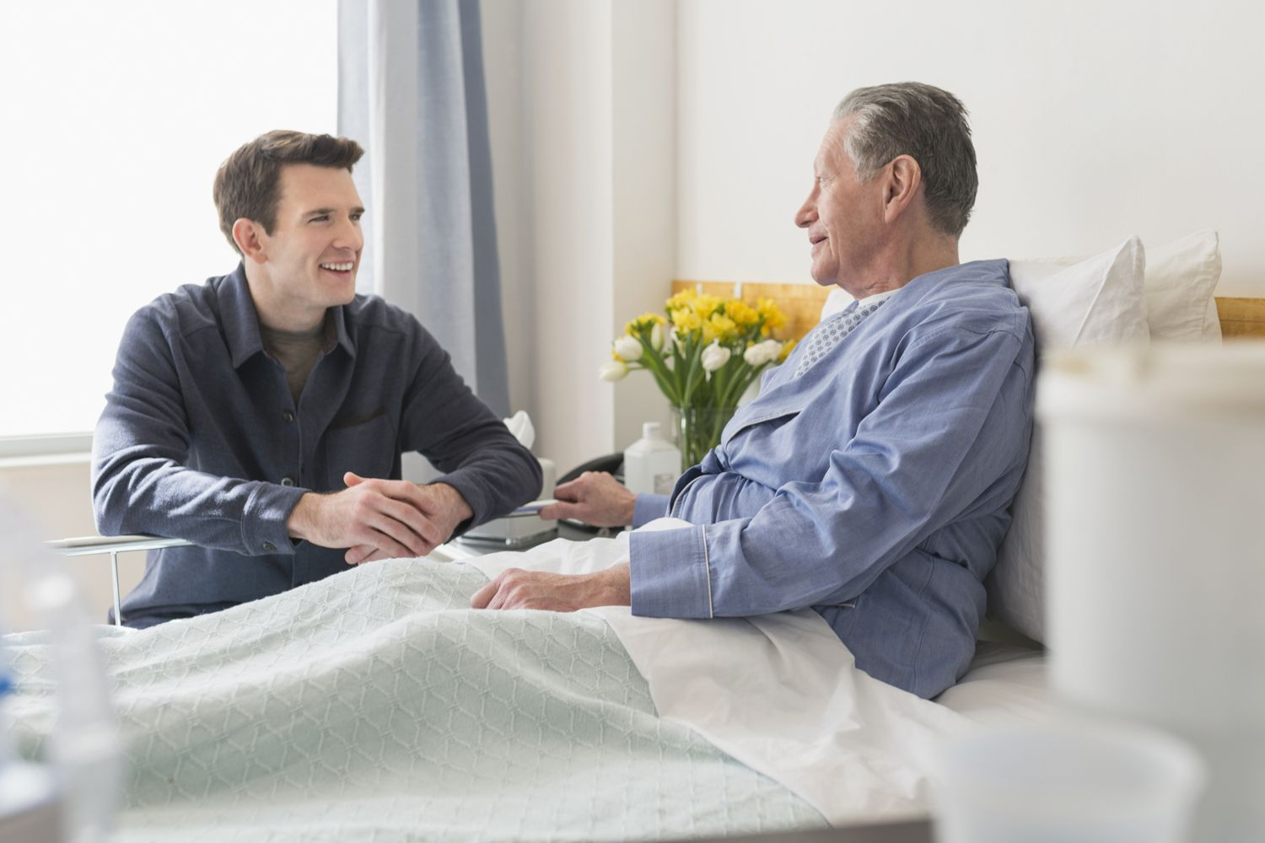
CONSOLATION
Brings the comfort of God’s Love
Brings inner peace and joy
Brings the Good News of Jesus Christ to another soul
Brings the personal visit of Our Blessed Mother herself to another soul
Brings compassion to sufferings souls

Slide 5
CONSOLATION
* Visitation of the Sick
* Hospital, Assisted Living, Nursing Home Visitation
* Consoling Bereaved Families
* Parishioner/shut-in/ elderly visitation
* Prison Visitation
* Conducting Paraliturgical Service in the parish
* Leading rosary for wakes or funerals
* Visitation and care of the handicapped or disabled

Slide 6
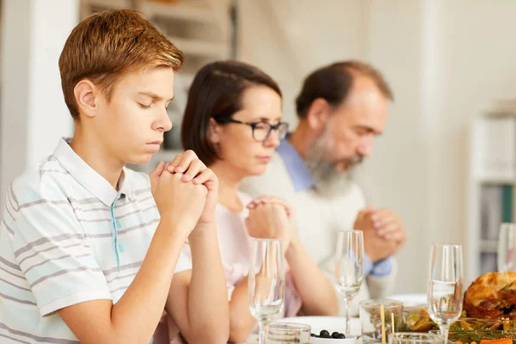
CONSERVATION
Promotion of the family as a domestic church
Catechism and Catholic Faith Formation
Reinforcing the practice of the Catholic Faith
Promotion of liturgy and Catholic devotions
Reinforcing the value of sacramentals

Slide 7
CONSERVATION
* Auxiliary Visitation
* Sacred Heart Enthronement
*True Devotion to the Nation
* Retreat Preparation/Coordination
* Distribution of Sacramentals
* Visitation of RCIA Graduates
* Running Junior Praesidium
* Sacred Heart Enthronement
* Running a Patrician Group
* Teaching catechism to children (CCD)
* Coordinate Bible Study

Slide 8
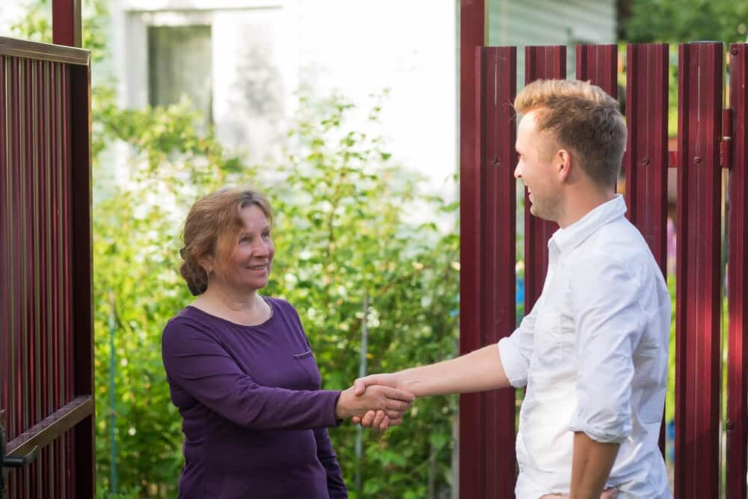
CONVERSION
Brings a soul closer to Jesus Christ through His Church
Brings fallen away Catholics back to the Church
Brings unity among all Christians
Brings non-Christians united to ONE CHURCH established by Jesus Christ
Brings unbelievers to become members of the Mystical Body of Christ

Slide 9
CONVERSION
*Crowd Contact/ Book Barrow; County Fairs/Street Evangelization
*Teaching catechism to children (RCIC)
*Teaching catechism to adults (RCIA, Adult Education)
*Door to Door Visitation (PEP, PPC, Exploratio Dominicalis)
*Doing parish census

Slide 10
2-hour weekly work of the Legion of Mary
LEGION WORKS
CONSOLATION
CONSERVATION
TO JESUS THRU MARY
CONVERSION
Consolation-comfort a soul
Conservation-reinforce the faith
Conversion-reclaim souls

