Slide 1

EXTENSION WORK
IN THE
LEGION OF MARy
SR. SEGGY ACOSTA

Slide 2
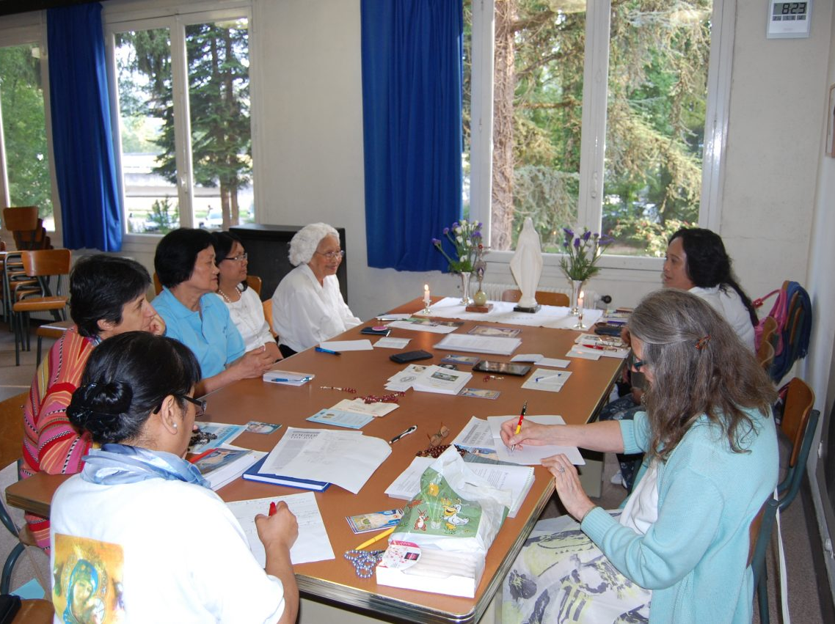
WHAT IS EXTENSION?
Extension is a plan of action to establish a Legion of Mary praesidium where they are none existent. This could be surrounding parishes with absence of a praesidium, a diocese where there is no Legion of Mary presence or on a larger scale, any territory where Legion presence is non-existent. A legionary serves as a lay missionary for the time-tested instrument in the propagation of the Catholic Faith.

Slide 3
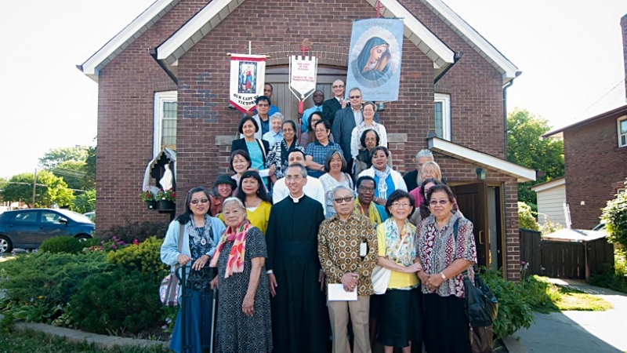
How is Extension Work initiated?
A request from a pastor who wants a Legion praesidium
A request from a legionary who was moved to another area without Legion presence
A request from a person who has heard of the wonders of the Legion of Mary and wants to have it in their parish
A letter sent to all parishes without Legion of Mary presence addressing to the pastor the benefits of having a Legion of Mary praesidium in his parish
A Bishop requesting the establishment of the Legion of Mary in his diocese

Slide 4
What materials will be beneficial to send to the bishop or pastor?
Leaflet on the Legion of Mary describing active and auxiliary membership
Booklet on the Legion and the Priest
A Tessera showing our Legion prayers
List of possible works to assist the pastor in his parish
Leaflet on the Benefits of the Legion of Mary
A copy of the Bishops’ Report

Slide 5
Pray and fast for successful extension efforts
Send a letter to the Bishop or Pastor
Follow-up with a phone call to make a personal visit and to ensure materials were received that were previously sent
Find out what are the needs of the Diocese or Parish to make the suggestions relevant to the needs
What are the Steps to take on Extension?

Slide 6
What are the Steps to take on Extension?
Request for names and contact numbers of people identified who are likely to show interest on this type of work
Identify with the pastor the possible dates for a recruitment drive, possible dates for an information session and target date to start a Legion of Mary
Inform the council of the interest expressed by a pastor in order to obtain material needed for the Recruitment Drive, Start-up kit for a new praesidium, and obtain volunteers to assist in the extension effort
Get help for the Recruitment Drive and identify the person/s to give the talks at Masses. Ask the pastor to give a talk on Legion.
Ensure that there are bulletin and pulpit announcements weeks before the Recruitment Drive to bring into focus the upcoming endeavor and make the project known to as many people

Slide 7
What are the Steps to take on Extension?
On the day of recruitment, the table must provide sufficient information on the Legion of Mary with a nice altar and free sacramentals. Sign-up sheets with clipboards must be made available to volunteers with notification of the organizational meeting date, time and location.
The Sign-up sheets will be used to follow up those who expressed interest to remind them of the meeting and answer questions concerning the Legion of Mary.
The pastor must identify his preferred time, day, location for the weekly meeting with likely spiritual director to guide the group
Set up a regular Legion of Mary altar and welcome the people who will show up, run a brief meeting, and offer refreshments after to allow time for socialization and answering of questions.

Slide 8
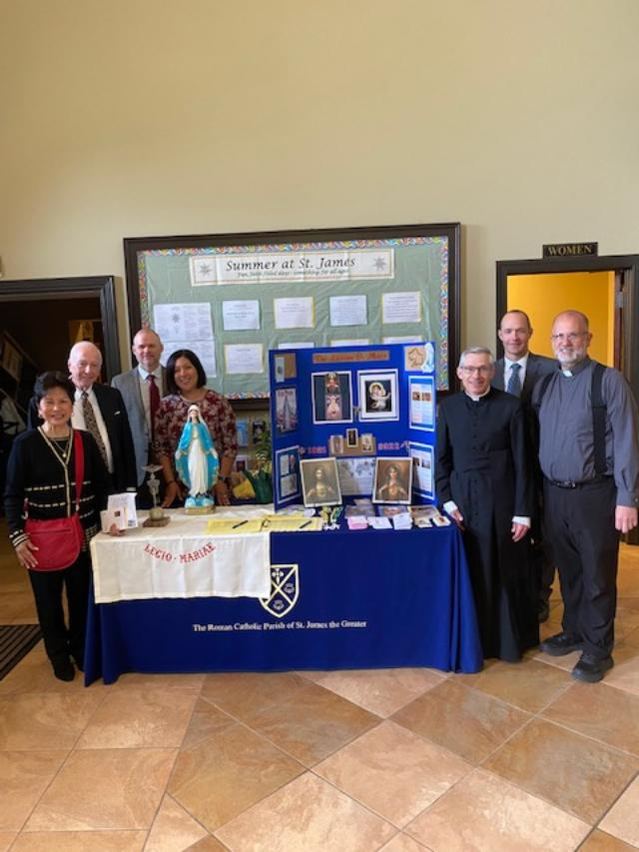
EXTENSION WORK AT
ST. JAMES THE GREATER CATHOLIC CHURCH IN JAMESTOWNWEST VIRGINIA

