Slide 1

DOOR TO DOOR
VISITATION
Sr. Seggy Acosta

Slide 2
PLANNING
MEET WITH THE PASTOR TO EXPLAIN HOW DOOR TO DOOR CAN BENEFIT THE PARISH. SET A DATE FOR THE ACTUAL PROJECT.
INQUIRE FROM THE PASTOR HIS PARISH TERRITORY/ BOUNDARY
REQUEST FOR AN ENLARGED COPY OF THE PARISH MAP WITH IDENTIFIED STREETS.
OBTAIN ASSISTANCE FROM THE PRAESIDIUM ASSIGNED TO THE PARISH TO GATHER NEEDED MATERIALS TO BE INCLUDED IN THE PACKETS TO BE DISTRIBUTED WITH COPIES OF PARISH BULLETIN AND LETTER FROM THE PASTOR.
ANNOUNCE THE UPCOMING DOOR TO DOOR TO OTHER PRAESIDIA TO OBTAIN HELP FOR THAT DAY OR WEEKEND.
ONCE VOLUNTEERS ARE OBTAINED, PAIR THE EXPERIENCED LEGIONARIES WITH INEXPERIENCED IN DOOR-TO-DOOR WORK.
DO A QUICK TRAINING BEFORE STARTING THE WORK ON THE ASSIGNED DAY.

Slide 3
ARRIVAL
Friday, July 21 Immaculate Conception Church
04:00pm-05:00p Meeting and Planning with Pastor
05:00pm-06:00pm Putting together of prepared handouts
Collection of maps of areas for evangelization
06:00pm-07:00pm Holy Rosary with Legion Prayers then Dinner
Saturday, July 22 Immaculate Conception Church
08:00am-09:00am Holy Rosary with Legion Prayers then Mass
09:00am-10:00am Breakfast and Training, distribution of materials
10:00am-12:00pm Door to Door Visitation
12:00pm-01:00pm Catena then Lunch with discussion
01:00pm-03:00pm Door to Door Visitation
03:00pm-0:400pm Discussion, Summary and Submission of Reports
Concluding Prayers
DEPARTURE

Slide 4
PREPARATION
Pray with your partner before going out on assignment.
One is to grab the bag of handouts to be given away with sacramentals on hand.
The other one has the paper and pen for documentation with direction/map of the area.
Put the address on the GPS to help with direction when driving.
Put a smile on your face and know that you are representing Our Blessed Mother who wants Jesus Christ to be known more to others. You are the image of the Catholic Church

Slide 5
INTRODUCTION
Make a sign of the Cross on the door then ring the door bell. Step back a few steps.
“Hello. We are visiting all the homes in the area on behalf of Father ______, the Pastor of ________________Catholic Church.”
“We are here to invite you to visit our church located on ___________Road. Have you seen our church or visited it?”
“We have a bag of gifts for you.” (Take out the literature and preferably, explain each)

Slide 6


Slide 7
We were wondering how we may be of service to you and your family?
Is anybody in this household Catholic?
Which church do you go to for worship?
Have you ever considered becoming a Catholic?
Would you consider praying right now for your family?

Slide 8
DO’S DON’T’S
Show interest on the person, the family members around. Be attentive &friendly.
Accept invitation to come in or to have a drink which will give more conversation.
Show empathy and kindness if they are not practicing, or left the church, or non-Catholic
Present the truth kindly as you hear any erroneous statement about the Catholic Church.
Encourage them to speak to a priest for clarification or desire to learn more.
Offer sacramentals and explain them
Offer services available in the church,
Do not argue despite of the circumstance. Listen and paraphrase what was said.
Do not talk about other neighbors.
Do not ask if they have time.
Do not make comments or facial expressions that could be misinterpreted.
Do not agree that all churches are the same. Ask them why they made such a statement.
Do not make things up if you do not know the answer. Request for a return visit.
Do not write in front of the family unless you asked permission. Do this outside.

Slide 9
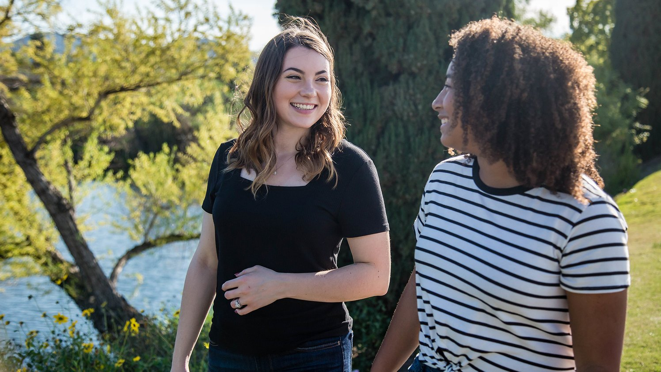

Slide 10

TRUST AND PRAY TO THE HOLY SPIRIT
BE THE FACE OF JESUS CHRIST
AND
THE BLESSED VIRGIN MARY TO OTHERS

